Slide 1



Slide 2
1.THE MAGIC OF LIFE
CONTENT:
. CHARACTERISTICS OF LIVING THINGS.
. MRS GREN
.IMPORTANCE OF LIVING THINGS
. DIFFERENCE BETWEEN LIVING AND NON-LIVING THINGS.
CHAPTER 14/KARUNAMBIGAI/SCIENCE DEPT/SNS ACADEMY

Slide 3
1.GROWTH
2.NUTRITION
3.MOVEMENT
4.RESPIRATION
5.SENSITIVITY
6.EXCRETION and
7.REPRODUCTION
LIFE PROCESSES

Slide 4
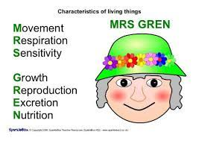
MRS GREN

Slide 5
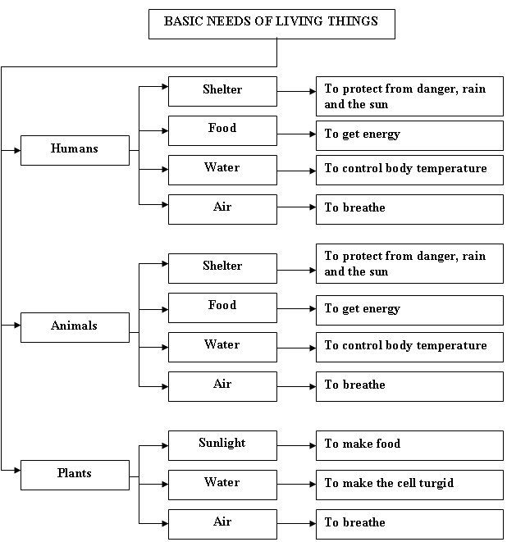
BASIC NEEDS OF LIVING THNGS

Slide 6
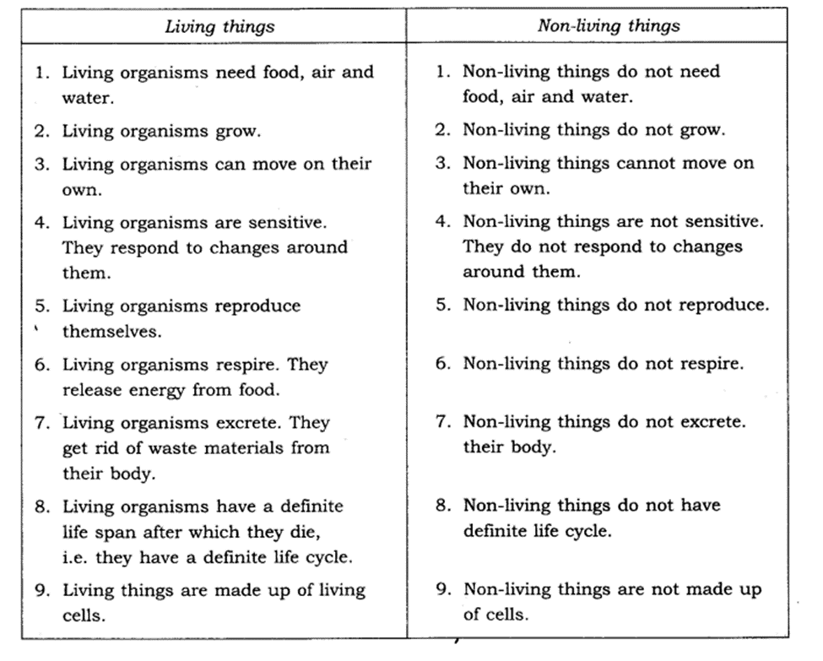
DIFFERNCE BETWEEN LIVING AND NON LIVING THINGS

Slide 7
1.WHAT IS A LIVING THING?
2.DEFINE STIMULUS.
3.WHAT IS EXCRETION?
QUESTION TIME

Slide 8


